Slide 1

Open-source, serverless web-mapping: A Case Study for the Agriculture Industry
Amy Farley | PENN STATE MGIS CAPSTONE PROPOSAL GEOG 596A – spring-2 2020 | ADVISOR: RYAN BAXTER

Slide 2
Presentation Outline
Project Purpose and Motivation
Project Background
Agriculture Industry Trends
Web-mapping
Open-source technology
Cloud computing
Project Objective
Proposed Methodology
Project Timeline

Slide 3
Presentation Outline
Project Purpose and Motivation
Project Background
Agriculture Industry Trends
Web-mapping
Open-source technology
Cloud computing
Project Objective
Proposed Methodology
Project Timeline

Slide 4
Project Purpose
Geospatial data management and visualization tool to make sense of the spatial data inundating the agriculture industry.

Slide 5
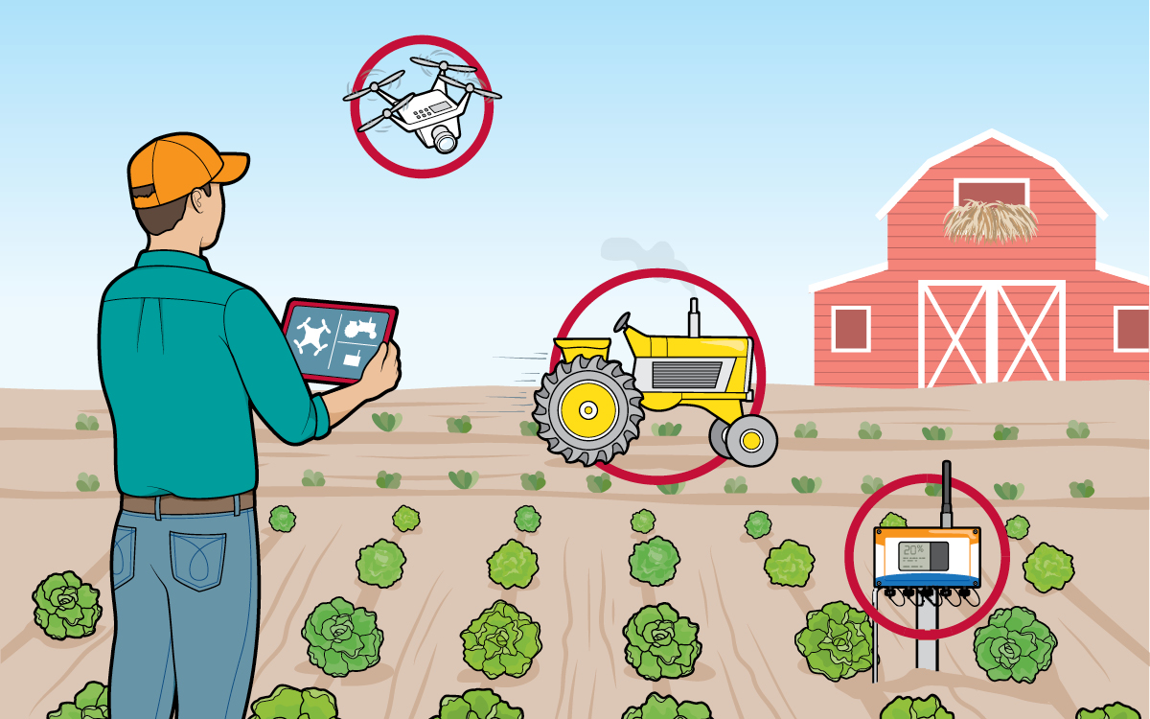
2018 Future Farming
© Sierra Club. All rights reserved.
Reproduced here for educational purposes only.

Slide 6
Motivation
20+ years developing software
Academic research in both proprietary and open-source GIS technologies
Personal relationships in the agriculture industry

Slide 7
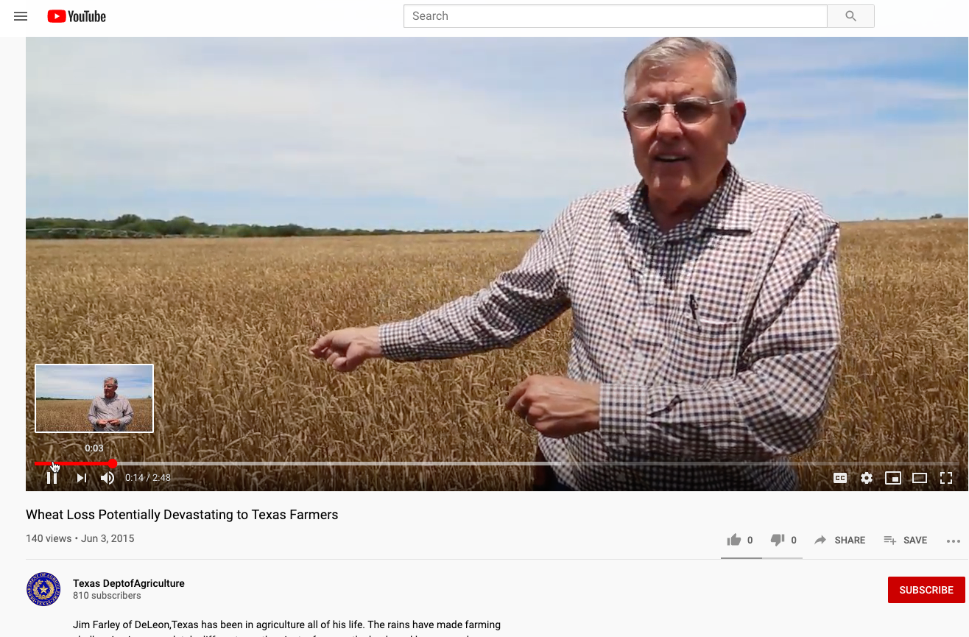
https://www.youtube.com/watch?v=Iqbo4_YYf-g&t=4s
2015 YouTube video of Jim Farley of De Leon, Texas
© Texas Department of Agriculture. All rights reserved.
Reproduced here for educational purposes only.

Slide 8
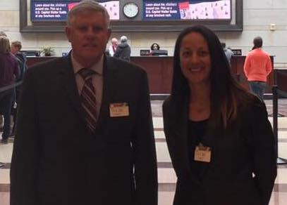
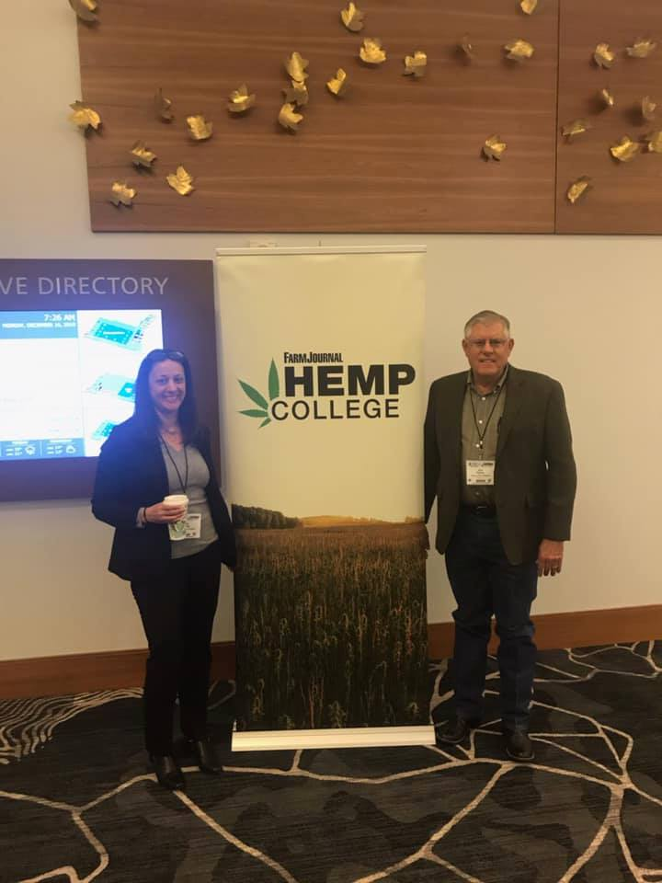


Slide 9
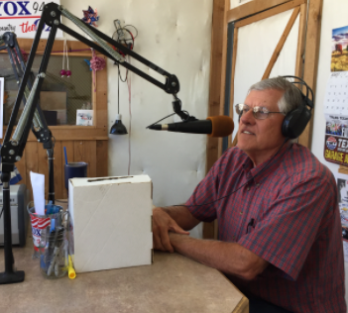
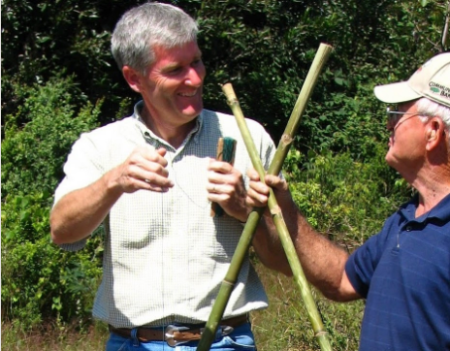

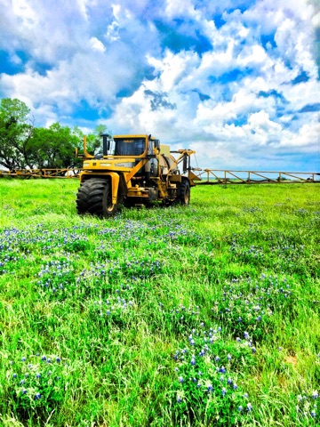

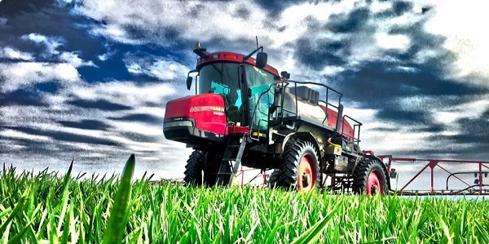
https://www.whitneyconsultinggroup.com
http://www.farleyfarmsupply.com
© 2019 Whitney Consulting Group. All rights reserved.
Reproduced here for educational purposes only.
Farley Farm Supply
© 2020 Farley Farm Supply All rights reserved.
Reproduced here for educational purposes only.

Slide 10
Presentation Outline
Project Purpose and Motivation
Project Background
Agriculture Industry Trends
Web-mapping
Open-source technology
Cloud computing
Project Objective
Proposed Methodology
Project Timeline

Slide 11
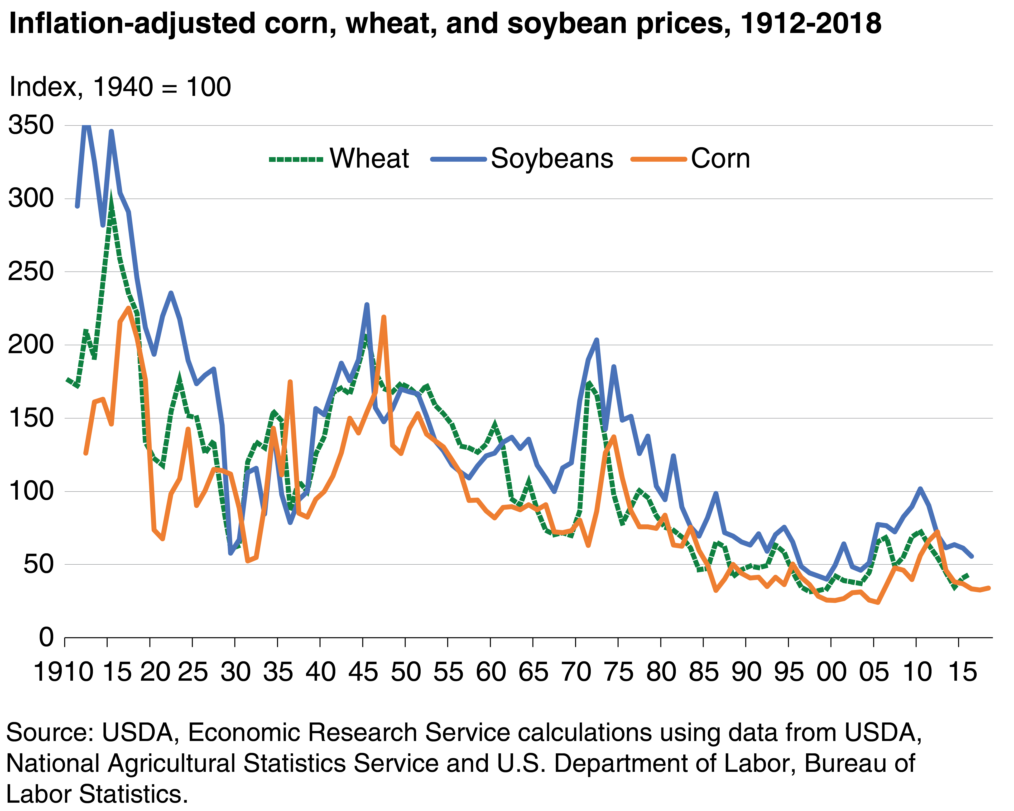
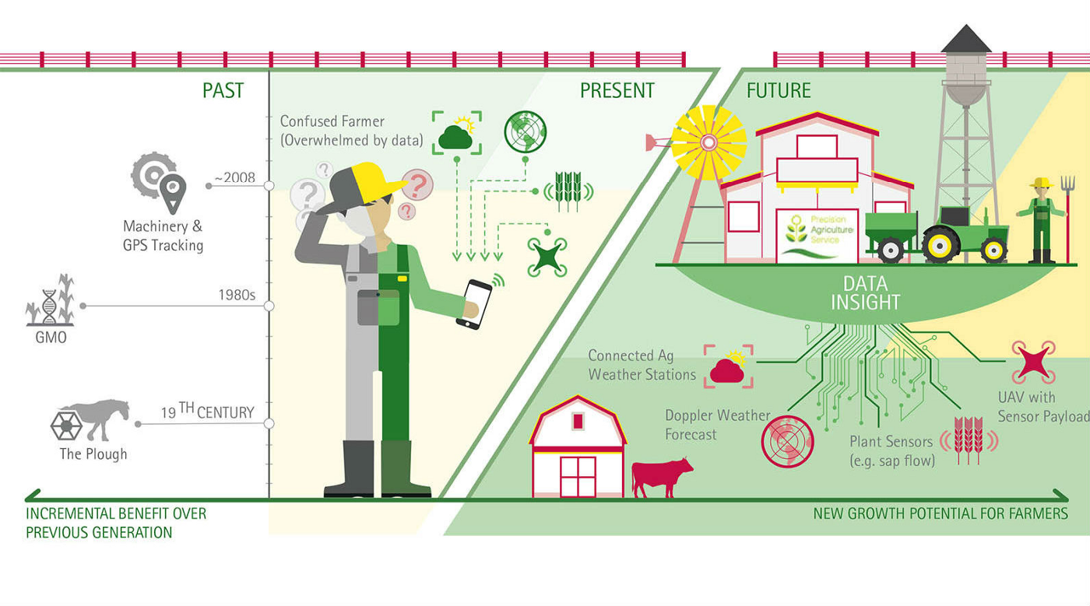
Agriculture Industry Trends
© 2019 United States Department of Agriculture All rights reserved.
Reproduced here for educational purposes only.
Evolution of Digital Agriculture, Source: Accenture
© 2018 Medium All rights reserved.
Reproduced here for educational purposes only.

Slide 12

Agriculture Industry Trends
Data Management
Affordable
Scalable
Easy to Use
Needs
Sustainable food production
Supply chain traceability
Transparency/Accountability
Drivers

Slide 13
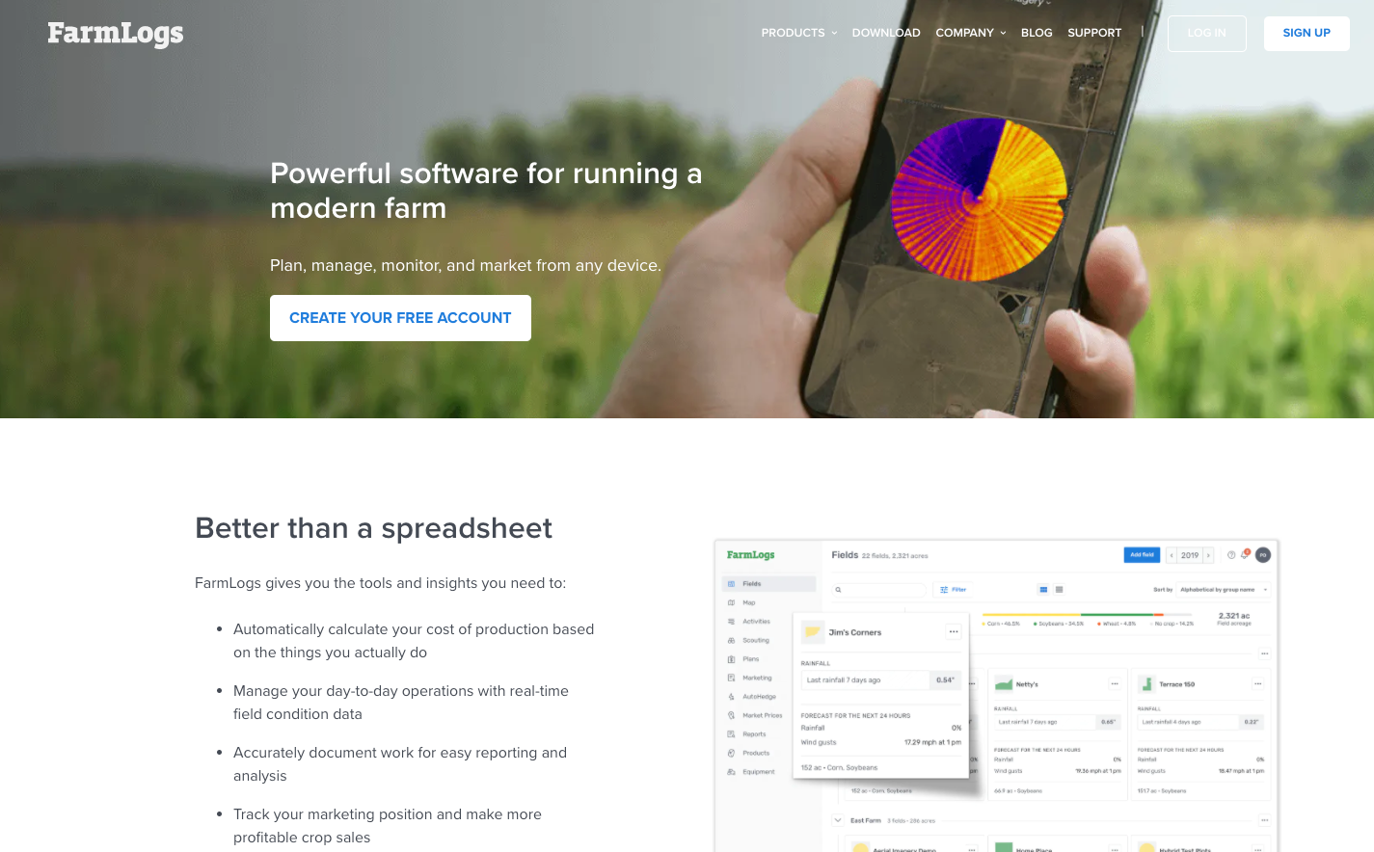
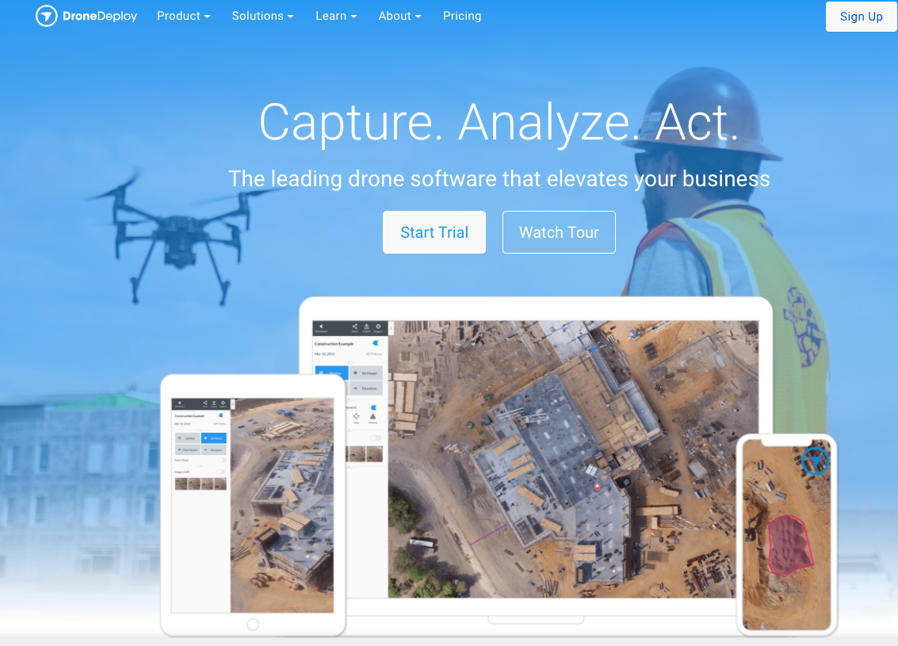
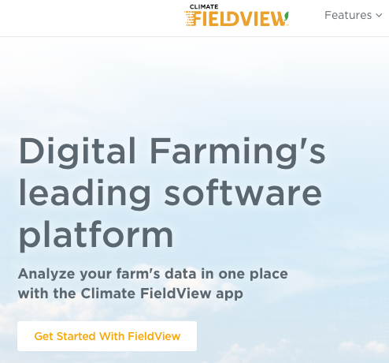
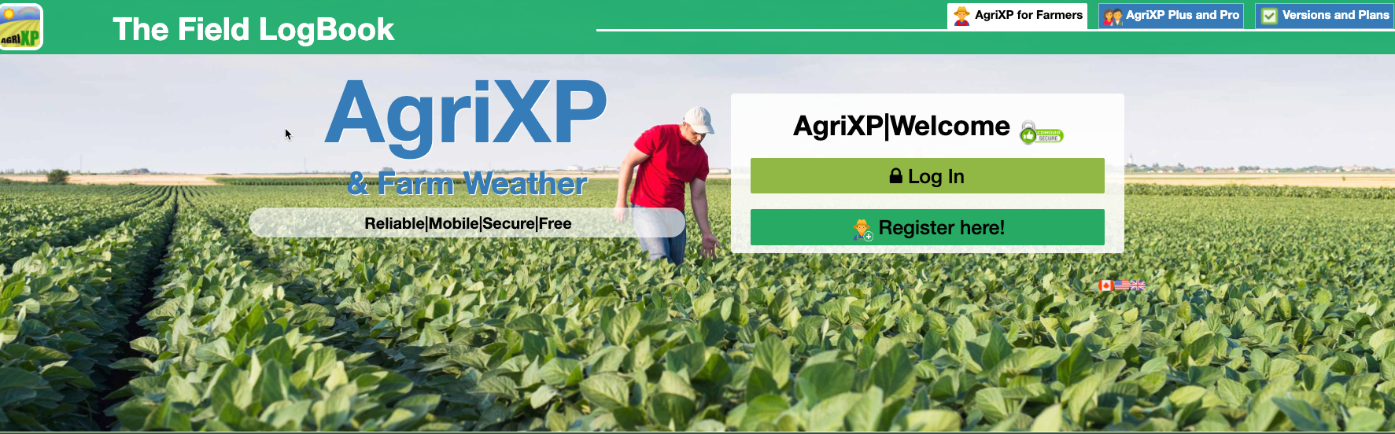
Existing Solutions
FarmLogs
© 2019 AgriSight, Inc. All rights reserved.
Reproduced here for educational purposes only.
DroneDeploy
© DroneDeploy
All rights reserved.
Reproduced here for educational purposes only.
Climate FieldView
© 2020 The Climate Corporation. All rights reserved.
Reproduced here for educational purposes only.
AgriXP Field LogBook
© 2020 AgriXP. All rights reserved.
Reproduced here for educational purposes only.

Slide 14
Solution Opportunities
Data Management
Affordable
Customizable/Scalable
Solution Ownership
Needs
Expensive
Very specific OR overly broad
Licensed/Proprietary code
Existing Solutions

Slide 15
Presentation Outline
Project Purpose and Motivation
Project Background
Agriculture Industry Trends
Web-mapping
Open-source technology
Cloud computing
Project Objective
Proposed Methodology
Project Timeline

Slide 16
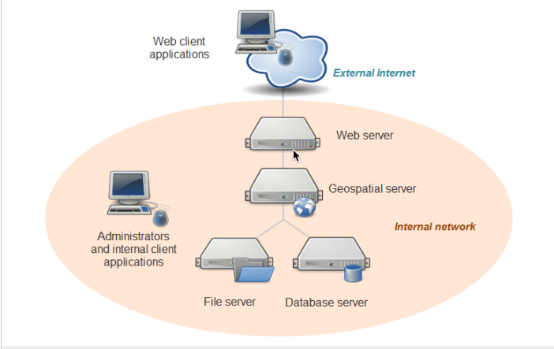
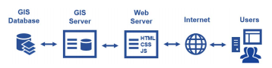
Web-mapping
Basic components and workflow of a web GIS as presented by BridgeDex researchers
© 2017 American Society of Civil Engineers. All rights reserved.
Reproduced here for educational purposes only.
System architecture for web-mapping applications presented by PSU
© Penn State College of Earth and Mineral Sciences, John A. Dutton e-Education Institute. All rights reserved.
Reproduced here for educational purposes only.

Slide 17
Presentation Outline
Project Purpose and Motivation
Project Background
Agriculture Industry Trends
Web-mapping
Open-source technology
Cloud computing
Project Objective
Proposed Methodology
Project Timeline

Slide 18
Open-source
In technology, this is code that is publicly available and free to use, modify, and distribute. (RedHat, 2020)

Slide 19
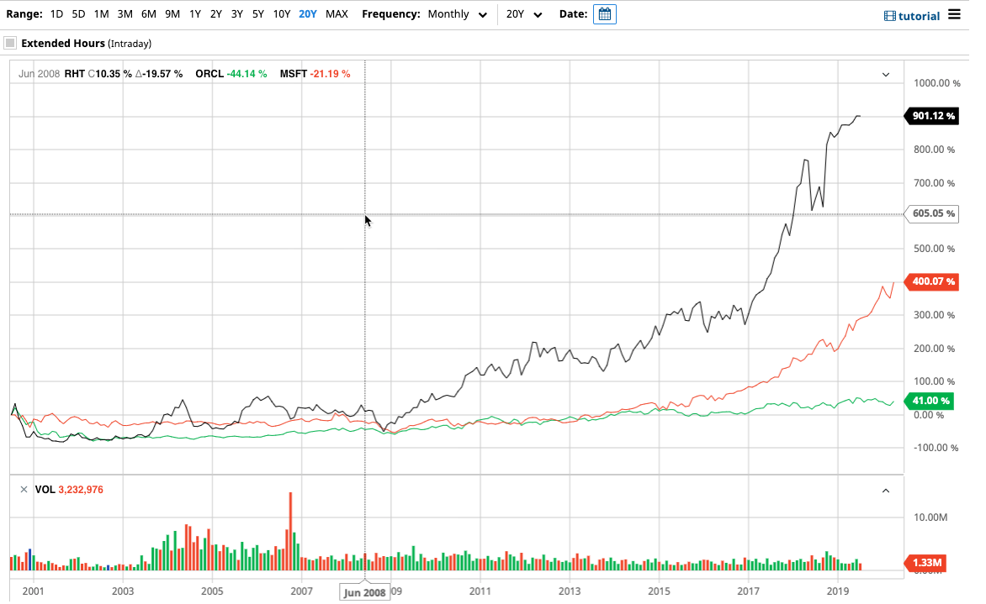
Open-source
RedHat change scale compared to Oracle and Microsoft – 20Y
© Barchart.com, Inc. All rights reserved.
Reproduced here for educational purposes only.

Slide 20
Open-source GIS
Database Layer | PostgreSQL/PostGIS, MySQL, SQLLite/SpatialLite
Geospatial/Application Layer | GeoServer, MapServer, GeoTools, Python GDAL/OGR, Apache Tomcat
Web/User Interface Layer | Apache HTTP Server, Leaflet, OpenLayers, Mapbox.js, Turf.js, D3, OpenStreetMap

Slide 21
Presentation Outline
Project Purpose and Motivation
Project Background
Agriculture Industry Trends
Web-mapping
Open-source technology
Cloud computing
Project Objective
Proposed Methodology
Project Timeline

Slide 22
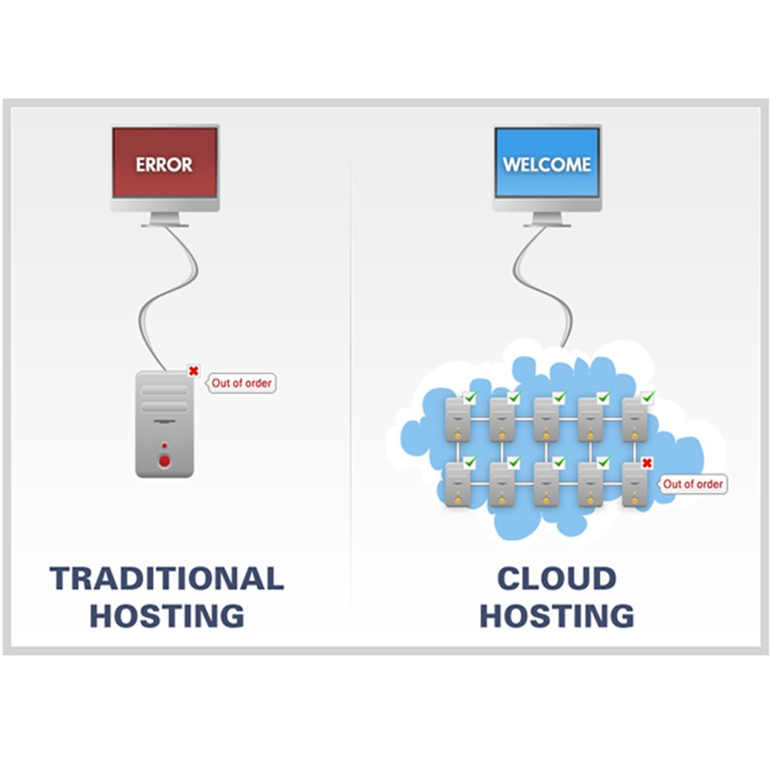
Cloud computing
Elasticity
Cost Reduction
Speed/Agility
Benefits
Difference Between Client-Server and Cloud Computing
© 2018 Simply2Cloud, Medium.com. All rights reserved.
Reproduced here for educational purposes only.

Slide 23
Cloud computing providers
Amazon Web Services (AWS)
Google Cloud Platform (GCP)
Microsoft Azure

Slide 24
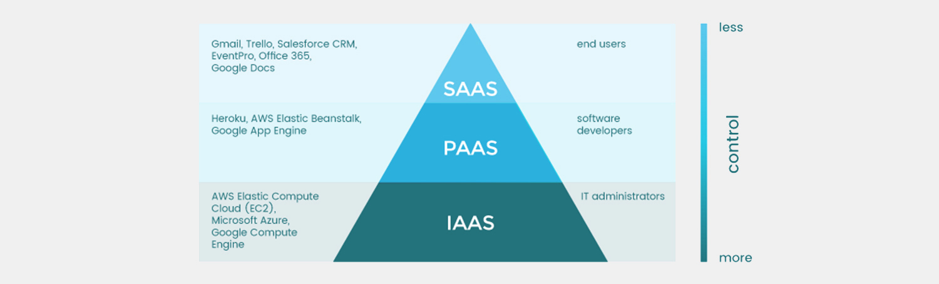
Cloud computing service models
IaaS Vs PaaS Vs SaaS – Cloud Service Models Compared
© 2019 Plesk International GMbH. All rights reserved.
Reproduced here for educational purposes only.

Slide 25
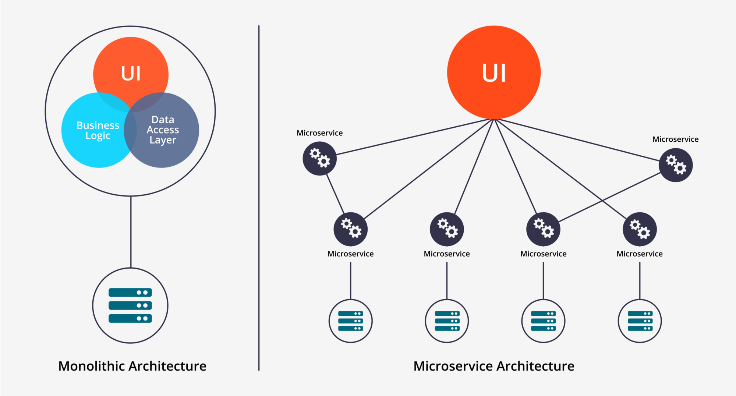
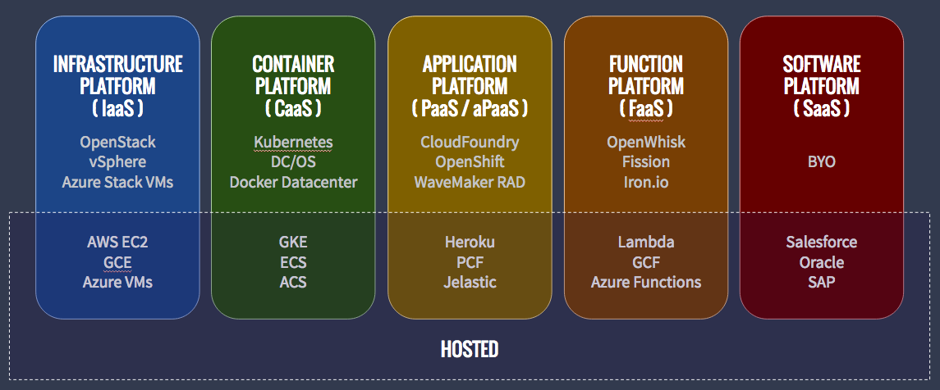
Serverless
Difference between IaaS SaaS PaaS CaaS FaaS!!
@ 2017 Nilesh Suryavanshi, Medium
All rights reserved.
Reproduced here for educational purposes only.
Microservices versus Monolithic Architecture
© 2017 Bhagwati Malav, Medium.com. All rights reserved.
Reproduced here for educational purposes only.

Slide 26
Existing Cloud GIS Solutions
ArcGIS Online
Google Earth Engine
PAOneStop
Climate FieldView
Granular Business
DroneDeploy
farmOS

Slide 27

Serverless GIS solutions?
© Can Stock Photo / Good_Stock

Slide 28
Examples of Serverless GIS solutions
2020 MGIS Candidate – Ed Santos “Considerations on Deploying Geoprocessing Workflows as Serverless Functions”
2019 GeoCon – Virginia GIS Conference – Timmons Group “Enhancing GIS with Cloud Technology and Serverless Computing”

Slide 29
Presentation Outline
Project Purpose and Motivation
Project Background
Agriculture Industry Trends
Web-mapping
Open-source technology
Cloud computing
Project Objective
Proposed Methodology
Project Timeline

Slide 30
Project Objective
Build a serverless, web-mapping application
Answer specific questions addressing the usefulness of this type of application

Slide 31
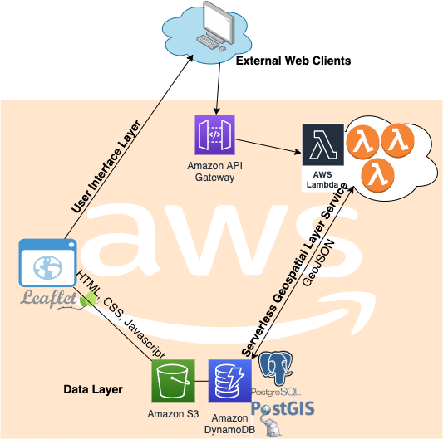
Project Objective
Serverless Web Mapping
© 2020 Amazon Web Services. © 2010–2019 Vladimir Agafonkin.
© OpenStreetMap contributor.
© 1996-2020 The PostgreSQL Global Development Group.
© PostGIS Project Steering Committee
All rights reserved.
Reproduced here for educational purposes only.
System architecture for web-mapping applications presented by PSU
© Penn State College of Earth and Mineral Sciences, John A. Dutton e-Education Institute
All rights reserved.
Reproduced here for educational purposes only.

Slide 32
Presentation Outline
Project Purpose and Motivation
Project Background
Agriculture Industry Trends
Web-mapping
Open-source technology
Cloud computing
Project Objective
Proposed Methodology
Project Timeline

Slide 33
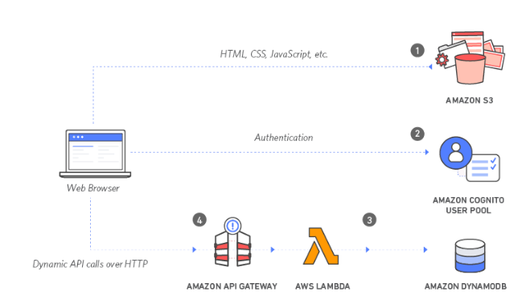




Proposed Methodology
AWS
PostgreSQL/PostGIS
Amazon S3 Buckets
AWS Lambda
Java/Python
Leaflet
GeoJSON
GeoJSON
© 2020 Amazon Web Services . © 2010–2019 Vladimir Agafonkin.. © OpenStreetMap contributor. © 2020 Oracle
© 1996-2020 The PostgreSQL Global Development Group. © PostGIS Project Steering Committee.
Reproduced here for educational purposes only.

Slide 34
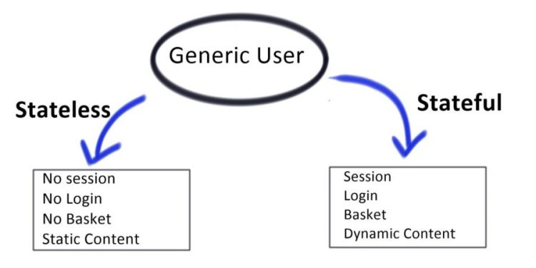
Expected Challenges
Performance
Stateless Architecture
Difference Between Stateful and Stateless
© 2018 R Interview Bubble. All rights reserved.
Reproduced here for educational purposes only.

Slide 35
Serverless Web Mapping Evaluation
Can a serverless web-mapping application be achieved with a stateless architecture or will statefulness have to be enforced?
Is the performance of the serverless web-mapping application acceptable?
Is the serverless web-mapping application usable?
Is the solution affordable?
Is the solution configurable and reusable?

Slide 36
Presentation Outline
Project Purpose and Motivation
Project Background
Agriculture Industry Trends
Web-mapping
Open-source technology
Cloud computing
Project Objective
Proposed Methodology
Project Timeline

Slide 37
Project Timeline - Milestones
Date | Milestone
July 22, 2020 | Spatial Database Management course ends
August 26, 2020 | Database layer of web-mapping application finalized
October 14, 2020 | Serverless web-mapping application overlaying at least one thematic layer from database for visualization functioning
October 28, 2020 | User-interface and serverless functions complete for drawing new vector boundaries for database storage
November 11, 2020 | User-interface and serverless functions for uploading and storing raster data
November 25, 2020 | User-interface and serverless functions for querying data spatially and by attributes
December 9, 2020 | User-interface and serverless functions for updating spatial and attribute data
December 23, 2020 | Temporal visualization features available
January 2021 | Submit intent to graduate
January – April, 2021 | Continued improvements to web-mapping application, presentation preparation, final project paper
May 2021 | Project presentation @ TNRIS GeoRodeo
*August 2021 | Submit intent to graduate
*October 2021 | Project presentation @ TNRIS GIS Forum
*November 2021 | Project presentation @ GIS Day events

Slide 38
Acknowledgments
Ryan Baxter – Penn State Graduate Advisor
Alex Pasadyn – Technical Lead, Bridgefront Capital
Jimmy McWilliams – History Professor, Texas State University
Bob Whitney – Agriculture Consultant and Researcher, Whitney Consulting Group
Jim Farley – Agronomist, Crop Consultant, Ag Retail Owner – Farley Farm Supply

Slide 39
References
* All references included at the end of the deck

Slide 40
Questions?

Slide 41
References
Agafonkin, V., & OpenStreetMap contributors. (2019a). Leaflet. https://leafletjs.com/
Agafonkin, V., & OpenStreetMap contributors. (2019b). Using GeoJSON with Leaflet. Leaflet. https://leafletjs.com/examples/geojson/
Agile Alliance. (2020). What is Agile? https://www.agilealliance.org/agile101/
AgriXP. (2020). AgriXP. https://agrixp.com/compare?lang=en
Amazon Web Services. (2020a). AWS Lambda Developer Guide. AWS Documentation. https://docs.aws.amazon.com/lambda/latest/dg/welcome.html
Amazon Web Services. (2020b). AWS Step Functions. https://aws.amazon.com/step-functions/
Amazon Web Services. (2020c). Build a Serverless Web Application. Projects on AWS. https://aws.amazon.com/getting-started/projects/build-serverless-web-app-lambda-apigateway-s3-dynamodb-cognito

Slide 42
References (continued)
Amazon Web Services. (2020d). Cloud Products.
Amazon Web Services. (2020e). Serverless Build and run applications without thinking about servers. Serverless Computing. https://aws.amazon.com/serverless/
Amazon Web Services. (2020f). What is cloud computing? https://aws.amazon.com/what-is-cloud-computing/
Applied Geographics. (2020). 2020 EDITION Aerial Imagery Provider Comparison Guide. https://www.mapgeo.io/aerial-imagery-comparison-guide
Asay, M. (2020). How open source might prove helpful during the coronavirus pandemic. TechRepublic. https://www.techrepublic.com/article/how-open-source-might-prove-helpful-during-the-coronavirus-pandemic/

Slide 43
References (continued)
Axis Maps. (2017). What is a web map? Cartography Guide. https://www.axismaps.com/guide/web/what-is-a-web-map/
Binh, T. T., Tien, P. D., Long, D. T., Truong, H. L., & Thanh, N. N. P. (2019). Building agricultural information system in An Giang province. An Giang University Journal of Science, 6, 89–99.
Bordogna, G., Kliment, T., Frigerio, L., Brivio, P. A., Crema, A., Stroppiana, D., Boschetti, M., & Sterlacchini, S. (2016). A spatial data infrastructure integrating multisource heterogeneous geospatial data and time series: A study case in agriculture. ISPRS International Journal of Geo-Information, 5(5), 1–27. https://doi.org/10.3390/ijgi5050073
Buytaert, D. (2020). Is Open Source recession-proof? https://dri.es/is-open-source-recession-proof
Carey, S., & Macaulay, T. (2019). What are the advantages of open source software in the enterprise? COMPUTERWORLD. https://www.computerworld.com/article/3412269/what-are-the-advantages-of-open-source-software-in-the-enterprise-.html

Slide 44
References (continued)
Castro, P., Ishakian, V., Muthusamy, V., & Slominski, A. (2019). The rise of serverless computing. Communications of the ACM, 62(12), 44–54. https://doi.org/10.1145/3368454
Cloudflare. (2020a). What Is Serverless Computing? | Serverless Definition. https://www.cloudflare.com/learning/serverless/what-is-serverless/
Cloudflare. (2020b). What Is Vendor Lock-In? | Vendor Lock-In and Cloud Computing. https://www.cloudflare.com/learning/cloud/what-is-vendor-lock-in/
Croptracker. (2020). Croptracker Farm Management Software.
Cubbage, S. (2019). Farm Journal AgTech Expo. Data Survival Guide 2.0.
Cubbage, S. (2020). Ag Could Have A Wild Ride In The Next Decade. Farm Journal AgWeb. https://www.agweb.com/article/steve-cubbage-ag-could-have-wild-ride-next-decade

Slide 45
References (continued)
Detwiler, J., & Sloan, J. (2020). Spatial Database Management. John A. Dutton e-Education Institute, College of Earth and Mineral Sciences, The Pennsylvania State University. https://www.e-education.psu.edu/spatialdb/
Dhanapal, Y., Mateer, C., & Timmons Group. (2019). Enhancing GIS with Cloud Technology and Serverless Computing. GeoCon 2019 Virginia GIS Conference Hosted by VAMLIS.
Dignan, L. (2020). Top cloud providers in 2020: AWS, Microsoft Azure, and Google Cloud, hybrid, SaaS players. ZDNet. https://www.zdnet.com/article/the-top-cloud-providers-of-2020-aws-microsoft-azure-google-cloud-hybrid-saas/
Dongoski, R., Selck, A., & Buie, B. (2017). Digital agriculture: influences, trends, and opportunities among ag retailers. EY. http://www.ey.com/Publication/vwLUAssets/ey-digital-agriculture-trends-ag--retail/$FILE/ey-digital-agriculture-trends-ag-retail.pdf

Slide 46
References (continued)
DroneDeploy. (n.d.). AI-Powered Drone Data Processing. https://www.dronedeploy.com/product/photogrammetry/
ESRI. (n.d.). What is GIS.
ESRI. (2019). A framework for deploying web GIS applications. ArcGIS Server. https://enterprise.arcgis.com/en/server/latest/create-web-apps/windows/a-framework-for-deploying-web-gis-applications.htm
EY Global. (2017). How digital agriculture and big data will help to feed a growing world. EY. https://www.ey.com/en_gl/advisory/how-digital-agriculture-and-big-data-will-help-to-feed-a-growing-world
Farley, A. (2019a). GEOG 585 Open Web Mapping - FOSS Web Mapping Application. The Pennsylvania State University. http://personal.psu.edu/alf33/
Farley, A. (2019b). GEOG 865 Cloud and Server GIS - Open-Source GIS in the Cloud. The Pennsylvania State University. http://personal.psu.edu/alf33/

Slide 47
References (continued)
Farley, J. (2020a). Interview.
Farley, J. (2020b). Interview. http://www.farleyfarmsupply.com/
Farmobile Editors. (2019). Trip 3: Extra Mile – Tracing food … how agdata aids growers. Farmobile. https://www.farmobile.com/trip-3-the-extra-mile-steve-cubbage-the-biggest-risk/
G2. (2020a). Best Crop Management Software. Best Agriculture Software. https://www.g2.com/categories/crop-management
G2. (2020b). Best GIS Software. https://www.g2.com/categories/gis
GISGeography. (2020). 30 GIS Software Applications [2020 Rankings]. GISGeography.Com. https://gisgeography.com/mapping-out-gis-software-landscape/
GitHub. (2020). GitHub. https://github.com/

Slide 48
References (continued)
Google. (2019). Google Earth Engine. https://earthengine.google.com/
Google. (2020a). Google Cloud for AWS Professionals. https://cloud.google.com/docs/compare/aws
Google. (2020b). Google Imagery Sales FAQ. https://support.google.com/mapsdata/topic/6250082?hl=en&ref_topic=6246343
Google. (2020c). Serverless computing. https://cloud.google.com/serverless
Granular. (2020). Granular.
Griffin, T. (2019). Farm Journal AgTech Expo. Blockchain: The Big Picture and the Nitty Gritty.
Helendi, A. (2018). How Much Money Can You Save By Going Serverless? Dashbird. https://dashbird.io/blog/saving-money-switching-serverless/

Slide 49
References (continued)
Heneghan, J. (2019). Farm Journal AgTech Expo. Sort Through The Data Overload. https://www.farmjournalagtechexpo.com/schedule
Jacoby, D., Wynden, A., Gao, B., Giannini, F. C., Costa, M., & Coady, Y. (2019). Geospatial Computing Collaborations. 2019 IEEE Pacific Rim Conference on Communications, Computers and Signal Processing (PACRIM), 1–8. https://doi.org/10.1109/pacrim47961.2019.8985053
Javadnejad, F., Gillins, D. T., Higgins, C. C., & Gillins, M. N. (2017). BridgeDex: Proposed Web GIS Platform for Managing and Interrogating Multiyear and Multiscale Bridge-Inspection Images. Journal of Computing in Civil Engineering, 31(6). https://doi.org/10.1061/(ASCE)CP.1943-5487.0000710
Jonas, E., Krauth, K., Schleier-smith, J., Gonzalez, J. E., Patterson, D. A., & Berkeley, U. C. (2019). Cloud Programming Simplified : A Berkeley View on Serverless Computing. 1–33.
Jones, A. (2018). Stateful vs. Stateless Architecture Overview. Bizety.Com. https://www.bizety.com/2018/08/21/stateful-vs-stateless-architecture-overview/

Slide 50
References (continued)
Land IQ. (2018). Land IQ Agriculture.
Matteson, S. (2018). How to decide if open source or proprietary software solutions are best for your business. TechRepublic. https://www.techrepublic.com/article/how-to-decide-if-open-source-or-proprietary-software-solutions-are-best-for-your-business/
Mello, U., & Raghavan, S. (2018). Bringing the power of Watson to farmers. IBM Research Blog. https://www.ibm.com/blogs/research/2018/09/smarter-farms-agriculture/
Microsoft. (2019). Serverless web application on Azure. Microsoft Azure. https://docs.microsoft.com/en-us/azure/architecture/reference-architectures/serverless/web-app
Microsoft. (2020a). Azure FarmBeats. https://www.microsoft.com/en-in/campaign/azure-farmbeats/
Microsoft. (2020b). What is cloud computing. Microsoft Azure. https://azure.microsoft.com/en-us/overview/what-is-cloud-computing/

Slide 51
References (continued)
Mozilla and individual contributors. (2020). Client-side storage. MDN Web Docs. https://developer.mozilla.org/en-US/docs/Learn/JavaScript/Client-side_web_APIs/Client-side_storage
Nolle, T. (2019). The key differences between stateless and stateful microservices. The Enterprise Architect’s Guide to Application State Management. https://searchapparchitecture.techtarget.com/tip/The-key-differences-between-stateless-and-stateful-microservices
Orlowski, A. (2019). Open Source Technology Could Be a Boon to Farmers. Civil Eats. https://civileats.com/2019/12/02/open-source-technology-could-be-a-boon-to-farmers/
OSGeo. (2020). The Open Source Geospatial Foundation. https://www.osgeo.org/
Pascaul, M., Alves, E., Almeida, T. De, França, G. S. De, Roig, H., & Holanda, M. (2012). An Architecture for Geographic Information Systems on the Web - webGIS. GEOProcessing 2012 : The Fourth International Conference on Advanced Geographic Information Systems, Applications, and Services, c, 209–214.

Slide 52
References (continued)
Paul, S. (2018). How GIS is enabling the agricultural sector. Geospatial World. https://www.geospatialworld.net/blogs/gis-in-agriculture/
Penn State Cooperative Extension, Penn State Geospatial Technology Program, L. A. L., & Day, R. (2011). PAOneStop Farm Mapping and E&S Planning System. https://paonestop.psu.edu/
Planet Labs. (2020). Planet Basemaps. https://www.planet.com/products/basemap/
Planet Labs Inc. (2020). Agriculture. https://www.planet.com/markets/monitoring-for-precision-agriculture/
PostGIS Project Steering Committee. (2020). ST_AsGeoJSON. PostGIS 3.0.2dev Manual. https://postgis.net/docs/ST_AsGeoJSON.html
Predictive Analytics Today. (2020). Top 9 Farm Management Software. Farm Management Software. https://www.predictiveanalyticstoday.com/top-farm-management-software/

Slide 53
References (continued)
Quinn, S. (2019). Open Web Mapping. John A. Dutton e-Education Institute, College of Earth and Mineral Sciences, The Pennsylvania State University. https://www.e-education.psu.edu/geog585/
Quinn, S., Baxter, R., & O’Brien, J. (2019). Cloud and Server GIS. John A. Dutton e-Education Institute, College of Earth and Mineral Sciences, The Pennsylvania State University. https://www.e-education.psu.edu/geog865/
Rajan, R. A. P. (2018). Serverless Architecture - A Revolution in Cloud Computing. 2018 10th International Conference on Advanced Computing, ICoAC 2018, 88–93. https://doi.org/10.1109/ICoAC44903.2018.8939081
Red Hat. (2020a). The Open Farmer. Open Source Stories. https://www.redhat.com/en/open-source-stories/farming-for-the-future/open-farmer
Red Hat. (2020b). What is open source? https://www.redhat.com/en/topics/open-source/what-is-open-source

Slide 54
References (continued)
Reynolds, D., Ball, J., Bauer, A., Davey, R., Griffiths, S., & Zhou, J. (2019). CropSight: a scalable and open-source information management system for distributed plant phenotyping and IoT-based crop management | GigaScience | Oxford Academic. GigaScience. https://doi.org/10.1093/gigascience/giz009
Rosenberg, J., & Mateos, A. (2011). The Cloud at Your Service. Manning Publications Co.
Rouse, K. L. (2020). Meat Inspection Act of 1906. Encyclopedia Britannica. https://www.britannica.com/topic/Meat-Inspection-Act
Ruppert, L. (2019). Farm Journal AgTech Expo. The Retailers’ Role in Adopting AgTech. https://www.farmjournalagtechexpo.com/schedule
Samdan, E. (2019). Containers vs. Serverless. DZone. https://dzone.com/articles/containers-vs-serverless

Slide 55
References (continued)
Sandoval, K. (2017). Defining Stateful vs Stateless Web Services. Nordic APIs. https://nordicapis.com/defining-stateful-vs-stateless-web-services/
Santos, E. (2020). Considerations on Deploying Geoprocessing Workflows as Serverless Functions.
Sarjeel, Y. (2019). Getting it right between EC2, Fargate and Lambda. Medium. https://medium.com/thundra/getting-it-right-between-ec2-fargate-and-lambda-bb42220b8c79
Skernivitz, T. (2019). How Ag Retailers Are Adding Value to Real-Time Data. CropLife. https://www.croplife.com/precision/how-ag-retailers-are-adding-value-to-real-time-data/
Software Connect. (2020). Farm Management Software. https://softwareconnect.com/farm-management/#products
Stenta, M. (2020). farmOS. https://farmos.org/

Slide 56
References (continued)
Taylor, T. (2019). 3 serverless development strategies for stateful applications. The Enterprise Architect’s Guide to Application State Management. https://searchapparchitecture.techtarget.com/tip/3-serverless-development-strategies-for-stateful-applications
Technopedia. (2020). Web Mapping. https://www.techopedia.com/definition/15584/web-mapping
The Climate Corporation. (2020). Climate FieldView. https://climate.com/
Tierra Plan. (2019). FIELD ANALYST. https://tierraplan.com/projects/field-analyst/
Trimble. (2020). What Is Precision Ag? https://agriculture.trimble.com/blog/what-is-precision-ag/
Tutorials Point. (2020). SDLC - Software Prototype Model. SDLC Tutorial. https://www.tutorialspoint.com/sdlc/sdlc_software_prototyping.htm

Slide 57
References (continued)
VMWare Tanzu. (2020). Cloud native applications: Ship faster, reduce risk, and grow your business. https://tanzu.vmware.com/cloud-native
Vogt, W. (2020). Changing customer impacts ag retail. https://www.farmprogress.com/technology/changing-customer-impacts-ag-retail
Watts, S., & Raza, M. (2019). SaaS vs PaaS vs IaaS: What’s The Difference and How To Choose. Bmc Blogs. https://www.bmc.com/blogs/saas-vs-paas-vs-iaas-whats-the-difference-and-how-to-choose/
Whitney, B. (2019). Interview. https://www.whitneyconsultinggroup.com/
Whole Foods Market. (2020). Whole Foods Quality Standards. https://www.wholefoodsmarket.com/quality-standards
Xia, D., Xie, X., & Xu, Y. (2009). Web GIS server solutions using open-source software. OSSC-2009 - Proceedings of 2009 IEEE International Workshop on Open-Source Software for Scientific Computation, 135–138. https://doi.org/10.1109/OSSC.2009.5416738

